Slide 1
IMM120 – 18 Sept
Making Things Move

Slide 2
Previously, in IMM120
1. If you wanted to make a variable called “oneHundred” and set it equal to 100, how would you write that in code?
var oneHundred = 100;
100 == 100 // equals true (watch the doubles)
var oneHundredX = 100; // no x required
88% Right

Slide 3
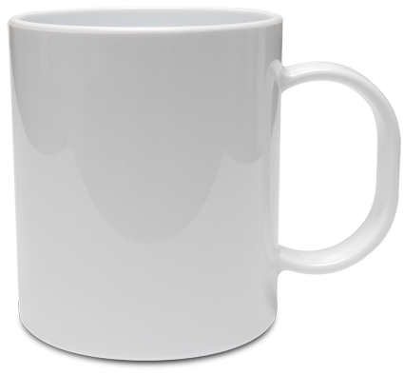
Variables and Their Names
Value
Name/
Label
ballSpeed

Slide 4
Variables and Their Names
x
xPos
xPosition
hPos
ballX
ballLeft
Jessie
y
yPos
yPosition
vPos
ballY
ballTop
Skyler

Slide 5
Previously, in IMM120
2. Which shapes do the following code samples produce?
if (4 < 5) {
triangle(…
} else {
ellipse(…
}
88% Right

Slide 6
Previously, in IMM120
2. Which shapes do the following code samples produce?
if (4 != 4) {
rect(…
} else {
line(…
}
100% Right

Slide 7
Previously, in IMM120
2. Which shapes do the following code samples produce?
if (!(14 > 80)) {
ellipse(…
} else {
triangle(…
}
94% Right

Slide 8
Previously, in IMM120
Feedback
Slow down (x4)
More visuals (x2)
Handouts? https://github.com/crhallberg/IMM120
will try to put on Canvas before class
Is it ok to go off and code something different?
Yes, but you must be coding!

Slide 9
Previously, in IMM120
Buzzer beaters
I may have misspoke last week:
If you hand in an assignment that clearly shows work but doesn’t demonstrate what I was looking for, I’m not going to hold it against you.
Please contact me if you’re not sure of the assignment or your idea.
Please contact me if you’re having trouble.
PS. You can turn in your assignments by putting your links on Canvas

Slide 10
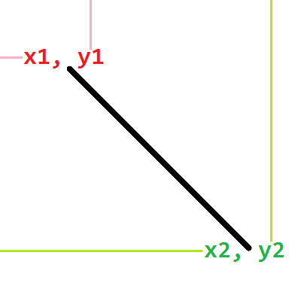
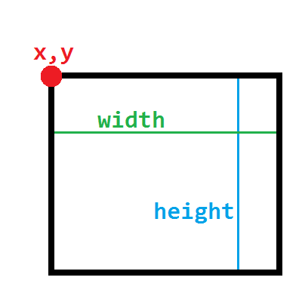
All the Shapes
line(x1, y1, x2, y2);
rect(cornerX, cornerY, width, height);

Slide 11
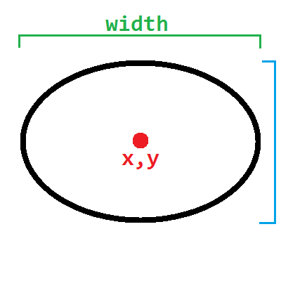
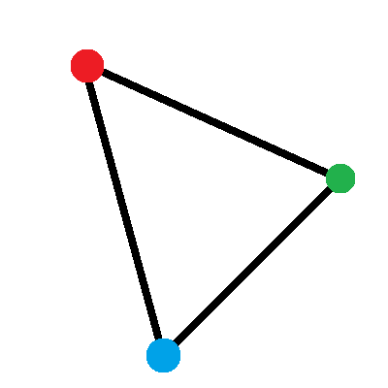
All the Shapes
ellipse(centerX, centerY, width, [h])
triangle(x1, y1 , x2, y2 , x3, y3);

Slide 12
https://p5js.org/reference
The best place for questions!

Slide 14
https://cdpn.io/e/VMYWqP
Starting point
Follow along! https://github.com/crhallberg/IMM120 : x1-Flappy Bird
Notes:
Walk through the code, take questions

Slide 15
Houston, we have a problem
noLoop(); - Stop the draw loop
loop(); - Restart the draw loop

Slide 16
Houston, we had a problem
At the bottom of setup(), add noLoop();
At the top of keyPressed(), add loop();

Slide 17
Hitting the World
Add a ground rectangle
In draw detect when our bird hits the ground
When it does, let’s…
set birdY to half way down the screen
run noLoop() again.
return;
Let's call this reset.
Notes:
Draw the canvas on the board, show what you mean

Slide 18
Between the Lines
Make a variable for the top line, set it to a random number that's not too low.
Make a variable for the bottom line, set it to your top line plus a good gap, so we always have the same size window.
Draw the two lines horizontally.
If we fly above the top line, reset.
If we fall below the bottom line, reset.

Slide 19
The Approaching Pipe
Make a new variable for the x position of the approaching pipe, starting all the way to the right (width).
Draw the line vertically.
Subtract 1 from the pipe's position each frame to make it come left.
Only do the check for the top and bottom lines if the bird is to the right of this approaching line.

Slide 20
A Pause For Functions
https://codepen.io/crhallberg/pen/veNQJo

Slide 21
Reset the Pipe
To reset the pipe we want to:
Position to the far right side.
Pick a new top and bottom line value.
You can do these in reset()
If the pipe plus its width is off the left side of the screen, reset the pipe.
If we hit the pipe with the bird, reset the pipe.

Slide 22
The Back of the Pipe
Make a new variable for the width of the pipe.
Add to our approaching pipe check to make sure we're to the left of our pipe plus its width.

Slide 23
Boolean Sentences
“if we're to the right of the approaching pipe and to the left of the pipe plus its width”

Slide 24
&& (Boolean AND)
A Boolean AND sentence is only true if both sides are true
"Sentence" | Resolves to | "Sentence" Result
4 < 5 && 10 > 6 | true and true | true
4 < 5 && 10 > 60 | true and false | false
14 < 5 && 10 > 6 | false and true | false
40 < 5 && 10 > 16 | false and false | false

Slide 25
Drawing Text
text(“words” / variable, x, y);
textSize(number);
textAlign(LEFT / CENTER / RIGHT);
https://p5js.org/reference/

Slide 26
DONE!
Party time!

Slide 27
Homework
Draw a pipe where it should go (use your variables).
Send me how your version turned out.

